Slide 1
Global Electronics MI
Corporate Research Desk
Dec, 2012

Slide 2



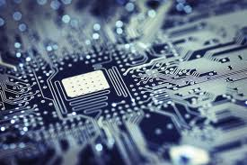



Global Electronics MI: Table of Content
Market Overview
Competitive Landscape
Deals Space
Business Trends
Technology Trends
Market Drivers
Market Future
Disclaimer:
The information presented in this report is based on data available in the public domain. If you find that it is incorrect, please let us know.
- 2 -

Slide 3
Global Electronics MI: Table of Content
Market Value
Market Overview
Market Segment
Competitive Landscape
Value Chain
Deals Space
Business Trends
Technology Trends
Market Drivers
Market Future
Disclaimer:
The information presented in this report is based on data available in the public domain. If you find that it is incorrect, please let us know.
- 3 -

Slide 4
Global Electronics MI: Market Overview Market Value
Global Electronic Equipment & Instruments
The global electronic equipment & instruments market consists of electronic equipment manufacturers market, the electronic manufacturing services market, and the technology distributors sector
The global electronic equipment & instruments industry had total revenues of $1,844 billion in 2011, representing a CAGR of 0.6% between 2007 and 2011
Market value: $ billion, 2007–11
The performance of the market is forecast to accelerate, with an anticipated CAGR of 5.6% for 2011 - 2016, to reach $ 2,426 billion by the end of 2016.
$ billion
% growth
Market value: $ billion, 2007–11
Year | $ billion | % Growth
2007 | 1797.4
2008 | 1824.7 | 1.52%
2009 | 1644.3 | -9.89%
2010 | 1767.7 | 7.50%
2011 | 1844.3 | 4.33%
CAGR: 2007–11 |  | 0.65%
Year
Notes:
Sources:
MarketLine: Global Electronic Equipment & Instruments Publication Date: may 2012

Slide 5
Global Electronics MI: Market Overview Market Segment
Global Electronic Equipment & Instruments
Market segmentation by Category: % share, by value, 2011
Category | 2011 ($ billion ) | %
Electronic equipment manufacturing | 1440.4 | 78.10%
Electronic manufacturing services | 219.5 | 11.90%
Technology distribution | 184.4 | 10.00%
Market segmentation by Geography: % share, by value, 2011
Category | 2011 ($ billion ) | %
Asia-Pacific | 1150.8 | 62.40%
Americas | 328.3 | 17.80%
Europe | 317.2 | 17.20%
RoW | 48.0 | 2.60%
Notes:
Sources:
MarketLine: Global Electronic Equipment & Instruments Publication Date: may 2012

Slide 6
Global Electronics MI: Market Overview Market Value
Global Electronic Manufacturing Services
The global electronic manufacturing services market consists of companies that manufacture electronic equipment mainly for OEMs (Original Equipment Manufacturers).
The global electronic manufacturing services industry had total revenues of $ 219.6 billion in 2011, representing a CAGR of 4.2% between 2007 and 2011
Market value: $ billion, 2007–11
The performance of the market is forecast to accelerate, with an anticipated CAGR of 5.2% for 2011 - 2016, to reach $ 283.1 billion by the end of 2016.
$ billion
% growth
Market value: $ billion, 2007–11
Year | $ billion | % Growth
2007 | 186.0
2008 | 185.6 | -0.22%
2009 | 160.0 | -13.79%
2010 | 194.6 | 21.63%
2011 | 219.6 | 12.85%
CAGR: 2007–11 |  | 4.24%
Year
Notes:
Sources:
MarketLine: Global Electronic Manufacturing Services Publication Date: may 2012

Slide 7
Global Electronics MI: Market Overview Market Segment
Global Electronic Manufacturing Services
Market segmentation by Category: % share, by value, 2011
Category | 2011 ($ billion ) | %
Computer applications | 85.64 | 39.0%
Consumer, medical and aerospace | 70.27 | 32.0%
Communications | 54.90 | 25.0%
Other | 8.78 | 4.00%
Market segmentation by Geography: % share, by value, 2011
Category | 2011 ($ billion ) | %
Asia-Pacific | 126.3 | 57.5%
Americas | 37.1 | 16.9%
Europe | 29.0 | 13.2%
RoW | 27.2 | 12.4%
Notes:
Sources:
MarketLine: Global Electronic Manufacturing Services Publication Date: may 2012

Slide 8
Global Electronics MI: Market Overview Market Value
Global Electronic Components
The electronic components market includes: passive components, such as resistors, capacitors, inductors, and passive filters; light-emitting diodes (LEDs) including laser diodes; printed circuit boards (PCBs); connectors; batteries; and similar products
The global electronic components industry had total revenues of $151.1 billion in 2011, representing a CAGR of -0.2% between 2007 and 2011
Market value: $ billion, 2007–11
The performance of the market is forecast to accelerate, with an anticipated CAGR of 8.7% for 2011 - 2016, to reach $ 229.7 billion by the end of 2016.
$ billion
% growth
Market value: $ billion, 2007–11
Year | $ billion | % Growth
2007 | 152.5
2008 | 155.6 | 2.03%
2009 | 119.8 | -23.01%
2010 | 143.7 | 19.95%
2011 | 151.1 | 5.15%
CAGR: 2007–11 |  | -0.23%
Year
Notes:
Sources:
MarketLine: Global Electronic Components Publication Date: may 2012

Slide 9
Global Electronics MI: Market Overview Market Segment
Global Electronic Components
Market segmentation by Category: % share, by value, 2011
Category | 2011 ($ billion ) | %
Connectors | 45.63 | 30.2%
PCBs | 34.90 | 23.1%
Resistors, capacitors, inductors | 33.70 | 22.3%
LEDs | 9.37 | 6.2%
Filters & oscillators | 6.80 | 4.5%
Other | 20.55 | 13.60%
Market segmentation by Geography: % share, by value, 2011
Category | 2011 ($ billion ) | %
Americas | 114.7 | 43.2%
Europe | 83.1 | 31.3%
Asia- Pacific | 53.9 | 20.3%
Middle East & Africa | 13.8 | 5.2%
Notes:
Sources:
MarketLine: Global Electronic Components Publication Date: may 2012

Slide 10
Global Electronics MI: Market Overview Market Value
Global Consumer Electronics
The consumer electronics market consists of the total revenues generated through the sale of audio visual equipment and games console products designed primarily for domestic use
The global electronic components industry had total revenues of $284.1 billion in 2011, representing a CAGR of 4.3% between 2007 and 2011
Market value: $ billion, 2007–11
The performance of the market is forecast to decelerate, with an anticipated CAGR of 3.9% for 2011 - 2016, to reach $343.6 billion by the end of 2016.
$ billion
% growth
Market value: $ billion, 2007–11
Year | $ billion | % Growth
2007 | 240.5
2008 | 251.5 | 4.60%
2009 | 250.8 | -0.28%
2010 | 271.5 | 8.22%
2011 | 284.1 | 4.65%
CAGR: 2007–11 |  | 4.25%
Year
Notes:
Sources:
MarketLine: Global Electronic Components Publication Date: may 2012

Slide 11
Global Electronics MI: Market Overview Market Segment
Global Consumer Electronics
Market segmentation by Category: % share, by value, 2011
Category | 2011 ($ billion ) | %
Audio and video | 257.4 | 90.60%
Games consoles | 26.7 | 9.40%
Market segmentation by Geography: % share, by value, 2011
Category | 2011 ($ billion ) | %
Americas | 116.5 | 41.00%
Europe | 81.0 | 28.50%
Asia-Pacific | 78.7 | 27.70%
Middle East & Africa | 8.0 | 2.80%
Notes:
Sources:
MarketLine: Global Electronic Components Publication Date: may 2012

Slide 12
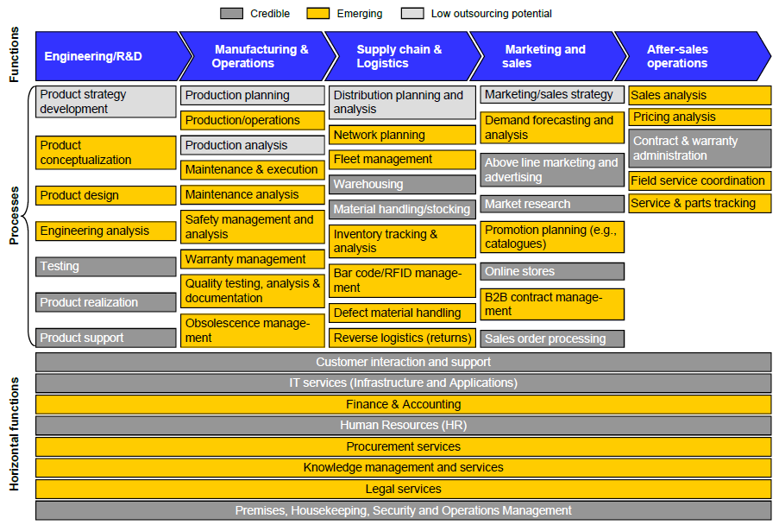
Global Electronics MI: Market Overview Value Chain
Significant scope of outsourcing a wide spectrum of services across the consumer electronics value chain.
- 12 -
Notes:
Source:
Everest Report: Outsourcing & Offshoring Trends in Consumer Electronics, January 2010

Slide 13
Global Electronics MI: Table of Content
Market Overview
Porter’s 5 Forces Analysis
Competitive Landscape
Industry Leaders
Deals Space
Business Trends
Technology Trends
Market Drivers
Market Future
Disclaimer:
The information presented in this report is based on data available in the public domain. If you find that it is incorrect, please let us know.
- 13 -

Slide 14
Global Electronics MI: Competitive Landscape Porter’s 5 Forces Analysis
Rivalry
• Similarity of players & products creates rivalry based on branding strength & players' ability to differentiate products through R&D innovation.
• Pricing is significant as a smaller step-down in price for one player could easily create price-war situation whereby margins are under threat.
• Decline in the market intensifies rivalry as players compete for market share.
Supplier Power
• Suppliers include - manufacturers of test gear, electronic components & related products or offering manufacturing services.
• Many companies, like Sony, operate their own manufacturing facilities; some may outsource certain components (e.g. LCD panels) or technologies to third parties.
•Consumer electronics manufacturing benefits from scale economies, and so it is likely that there will always be a preponderance of large manufacturers upstream of the retailers
• Suppliers must be financially sound, skills base should merge with the company, should have strong distribution network; meet environmental standards
New Entrants
• High fixed costs & initial capital outlay.
• Scale economies are important, except high-end ‘boutique’ products.
• Govt. regulation is not burdensome.
• New players face costs complying with regulations on recycling, waste disposal and on safe handling of chemical substances
• Market is populated by strong brands, to which end-users can be loyal.
• Switching costs are not very high.
• Deceleration in the market, currently in decline, discourages entry
Buyer Power
• Players might forward integrate or sell directly to consumers, reducing buyer power.
• Larger buyers may ‘backwards-integrate’ offering consumer electronics under their own brands.
• Largest & best-known players are important having brand name and trust.
Threat of Substitutes
• Retailers strongly influenced by end-user demand in adoption of substitutes.
• Potential substitutes include: PCs, functioning as home entertainment centers & home offices; games consoles, fulfilling similar leisure functions to audio and video products; smartphones, like iPhone & mobile phones using Google’s Android platform
• While companies like Toshiba are active in PC market, Sony has substantial share of consoles market.
• They also face indirect competition from companies like Lenovo who do not operate in consumer electronics market.
- 14 -
Notes:
Sources:
Datamonitor

Slide 15


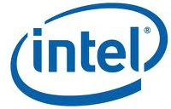






Global Electronics MI: Competitive Landscape Industry Leaders- SIGMA
Top 5 SIGMA- Samsung, Intel, Google, Microsoft, Apple
Complex Relationship: While they sometimes compete directly, these companies do not compete head to head in all their markets, but rather have sophisticated and at times, challenging relationships where they cooperate and compete together
They are investing in electronics markets such as phones, tablets, mobile computers and personal computers, as well as in the ecosystems and supporting infrastructure that drive and support electronics markets
All of them are customers and/or partners of each other in one way or another in various markets.
Buys Chips
Buys Chips
SIGMA
Buys Software
Buys Android
Buys Chips
PCs and servers
- 15 -
Notes:
Sources:
Gartner: Competitive Landscape: Five Titans Steer the Direction of the Electronics Industry

Slide 16
Global Electronics MI: Competitive Landscape Industry Leaders- SIGMA- Influence on the Industry
The Top Five Companies' Influence on the Electronics Industry, 2006 to 2012
Apple
Microsoft
Samsung
Intel
Google
2012
2009
2006
High
SIGMA- The companies are not only the industry leaders but also their decisions and innovative approaches have repercussions in all other electronics markets
Resources
In 2006, Apple and Google were dwarfed by the other three companies. Google had $11 billion in revenue and $3.1 billion in profits, while Apple had $19 billion and $2 billion, respectively. Following these was Intel, with almost double Apple's revenue and more than double its profit
by 2Q12, the situation had changed extensively. On a TTM basis in 2Q12, Apple had reached $149 billion, only $4 billion below Samsung and its profits had reached $40 billion
Low
These revenue and profit amounts also aligned with the R&D and capital investments that Apple and Samsung had made
Low
Ecosystem
High
- 16 -
Notes:
Sources:
Gartner: Competitive Landscape: Five Titans Steer the Direction of the Electronics Industry

Slide 17
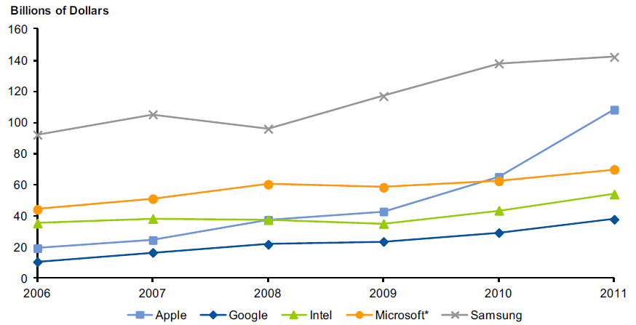
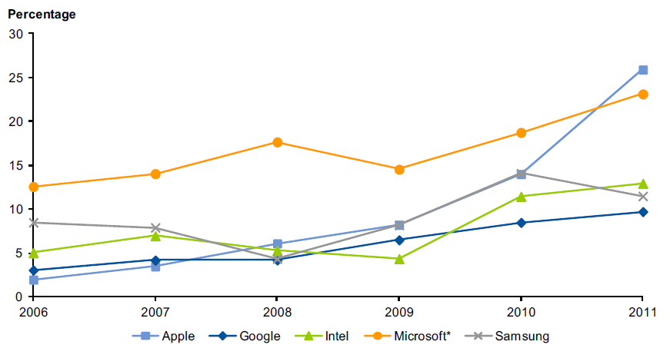
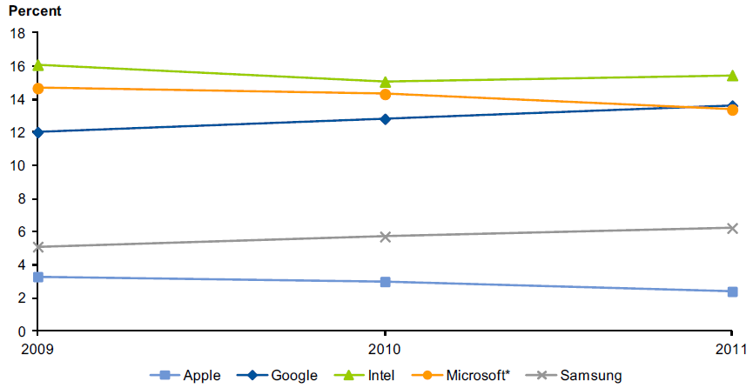
Global Electronics MI: Competitive Landscape Industry Leaders- SIGMA- Influence on the Industry
Revenue for SIGMA, 2006-2011 (Billions of Dollars)
Profit Margins for SIGMA (as a Percentage of Revenue), 2006-2011
R&D for SIGMA (as a Percentage of Revenue), 2009-2011
Apple: had a viable personal computer business in 2006, but limited influence beyond its media players and the iTunes store. But by 2012, Apple had established a strongconnection with its customers for computers, smartphones and tablets, becoming the leading electronics ecosystem.
Google : had strong position in a variety of Internet capabilities in 2006. By 2012 the company has extended its ecosystem to include content services
Intel, Microsoft: had set road map for the personal computer and server industries over the 2006 (and earlier) to 2012
Samsung: has grown its large portfolio of successful consumer electronics products during 2006 to 2012, and in particular, has become the No. 1 handset vendor on a unit basis
- 17 -
Notes:
Sources:
Gartner: Competitive Landscape: Five Titans Steer the Direction of the Electronics Industry

Slide 18
Global Electronics MI: Table of Content
Market Overview
Competitive Landscape
Deals Space
Important Contracts
Business Trends
Technology Trends
Market Drivers
Market Future
Disclaimer:
The information presented in this report is based on data available in the public domain. If you find that it is incorrect, please let us know.
- 18 -

Slide 19
Global Electronics MI: Deals Important Contracts
Electronics Contracts till date
Existing Contracts (As of Dec ,2012)
Contracts Expiring in 2012
Contracts Expiring in 2013
- 19 -

Slide 20
Global Electronics MI: Table of Content
Supply Chain Transformation
Market Overview
Supplier Collaboration
Competitive Landscape
Changing Production
Demand for Integrated Solutions
Deals Space
Product & Service Blending
Business Trends
Multi Channel Purchasing
Outsourcing Non-Core Operations; Vertically Integrating Core Competencies
Technology Trends
Reverse Logistics
Market Drivers
Sustainability & Green Supply Chain
Market Future
E-Commerce
Internet-Enabled Consumer Devices on the Rise
Disclaimer:
The information presented in this report is based on data available in the public domain. If you find that it is incorrect, please let us know.
- 20 -

Slide 21
Global Electronics MI: Business Trends Supply Chain Transformation
Supply Chain Transformation & investment in resiliency
Electronics supply chains have faced extreme demand volatility from the global recession and a halting recovery to the fast-paced life cycle of consumer products (CP), such as media tablets.
Driving revenue and sustaining competitive advantage while delighting customers would require an executable supply chain transformation strategy
Global demand volatility and the need to balance varied customer requirements will drive supply chain leaders to invest in developing profitable, segmented supply responses
On the service side of the equation, this could take the form of differentiated perfect order rates, order fulfillment lead times or speed
Risk Management- In a recent Gartner survey of 34 companies, only about one-third had any sort of visibility beyond their Tier 1 suppliers, and nearly one-half had no plans to implement this capability in the future
As a result, the supply chains of many manufacturing companies are potentially vulnerable to unexpected shortages or disruptions of critical components or materials upstream in the supply chain- Recent Thailand flood, Japan earthquake reinstated the focus on the loose end of such supply chain management
Key Drivers :
Extreme volatile demand calls for more effective and cost efficient supply chain management
Eurozone Crisis, US debt crisis, Japan earthquake makes the demand and supply side both unstable
Worldwide reach of the consumer electronics giant, serving various consumer segments requires supply chain transformation to retain the competitive advantage
Shape of Things to Come:
The companies need to identify the unique requirements of different customers. Identify clusters of demand is utmost important, so that one can develop corresponding value chain capabilities aligned with priorities such as efficiency, speed to customer and resiliency
Supply chain managers will go back to reevaluate the layout of their supply network designs and contingency plans with bottleneck suppliers to make them more resilient to future catastrophes.
Many costs are shared across assets such as factories, overhead and organizational support
An organization must know the complexity required to support a product or service across the end-to-end network to properly quantify costs
By identifying the impacts of trade-offs to provide specific service levels in the network design, cost to serve can dynamically estimate segmentation's impact to marginal profitability
To remain competitive in the volatile market the consumer electronics companies would be looking for revamping their supply chain
Notes:
Sources:
Gartner : Supply Chain Outlook, 2012: High-Tech Leaders Deliver Total Solutions and Increase Resiliency

Slide 22
Global Electronics MI: Business Trends Supplier Collaboration
Supplier Collaboration
The electronics value chain is very symbiotic. Unlike other manufacturing segments, such as automotive, there isn't always a definitive hierarchy between the brand owner and tier suppliers
A supplier's ability to innovate and execute reliably is critical to a product line's success.
The common challenges in supplier collaboration are exchanging product information and processing engineering change orders.
The companies are concerned about protecting the intellectual property but also concerned about the success of their products
The companies are looking for portal investments that can let key suppliers in while limiting the company's risk
Key Drivers :
Ever decreasing time line for new product launch, innovation, concern over quality as well as cost- pushing the electronics company to explore more into supplier collaboration
Shape of Things to Come:
Companies have identified supplier collaboration as a high priority at their company and a critical element of their product lifecycle initiatives
The initiatives being undertaken largely involves technology-enabled collaboration — data exchange, process harmonization, scorecards, and unified communication
PLM software and portal platforms are seen as central to aligning requirements to design, testing, and validation
For example, Intel and Microsoft play a huge role (and capture a significant share of profits) in the personal computer/laptop segment
The supplier collaboration must extend past design and first article test and continue throughout the entire life cycle.
Notes:
Sources:
Gartner : Supply Chain Outlook, 2012: High-Tech Leaders Deliver Total Solutions and Increase Resiliency

Slide 23
Global Electronics MI: Business Trends Changing Production- OBM & Vertical Integration
Original brand marketer (OBM) & Partial Vertical Integration
This supply model is followed by brand owners that market and sell electronic equipment, but have little or no involvement in electronics design, manufacturing or semiconductor purchasing
This model often involves leveraging reference designs from a semiconductor company or an electronics manufacturing service (EMS) company/ original design manufacturer (ODM), then modifying it based on functionality, price and form factors
Partial Vertical Integration – this supply model is followed by brand owners that design and develop key functional elements of electronic equipment, including the semiconductors.
The final design and key components purchased are managed mainly by the branded electronics firm, with manufacturing completed by key EMS and ODM partners.
Key Drivers :
OBM model has become significant since some brand owners have better insight into consumer demand and because successful sales for consumer electronics is less to do with engineering abilities and more to do with aesthetics and consumer fashion
Shape of Things to Come:
Major EMS and ODM-oriented companies (such as Foxconn) are extending their influence by forging links directly with mobile operators to build operator-branded handsets
They are also acquiring retail channel outlets in mainland China
Extending their vertical reach to retail sales, and enabling foreign brands to compete more directly with local Chinese brands in the high streets and shopping malls of China.
Examples include Gucci, Levi's and Verizon in mobile phones, and Polaroid in digital still cameras (DSCs).
Companies with their strength mainly in their brand (and aesthetics) are proving they can compete with companies that have their strength mainly in their engineering.
Notes:
Sources:
Gartner : Agenda for Electronic Equipment, 2012

Slide 24
Global Electronics MI: Business Trends Smartphone Design – Demand for Integrated Solutions
Demand for Integrated Solutions
The growing pressure to reduce overall system costs, minimize power consumption and reduce the physical size of the board is driving system designers to increasingly favor an integrated solution over discrete chips, when available.
Therefore, all future mobile devices, irrespective of the software platform or the hardware architecture they may support, will be called upon to integrate multiple functionalities
Low-cost smartphones use integrated chips (compared to premium smartphones that use stand-alone chips) in order to keep the semiconductor bill of materials lower, and hence the final system cost low as well
Key Drivers :
The integrated solution demand will be mainly driven by the low cost smart phones as they will be trying to keep the component bill lower to remain competitive
Shape of Things to Come:
With global penetration at about 45% of the overall mobile phone installed base, smartphones have the potential for high unit-volume growth over the next five years
But the future growth in smartphone shipments is expected from low-cost smartphones
Low-cost smartphones will be increasingly becoming the test bed for those chip vendors experimenting with increased functional integration
Mobile device manufacturers must understand the critical capabilities (and limitations) of semiconductor vendors' functional integration road maps in order to decide which features and functions are affordable for future mobile device designs
Notes:
Sources:
Gartner : Agenda for Electronic Equipment, 2012

Slide 25
Global Electronics MI: Business Trends Product & Service Blending
Product & Service Blending
Apple makes a lot more profit on iTunes than it does on the iPod device.
And the same product and service combinations can be seen across the consumer electronics industry — phones and apps, books and readers, games and systems, and so forth
At the last major iteration of game console technology, the major players — Microsoft (Xbox 360), Sony (PS3), and Nintendo (Wii) — had to decide what to do about backward compatibility for games from the previous generation
Nintendo didn't have much of an issue because its processor hadn't advanced enough to cause a compatibility problem, Microsoft chose to include a software emulation of the previous system, and Sony actually included the old processor along with the new in the system
These sorts of choices must be made and can substantially impact market outcomes
Another challenge is the digital service supply chain. The commerce captains (e.g., Apple, Sony, Microsoft, and Amazon) must coordinate payments to content providers upstream while managing various channel affiliation rewards downstream.
Key Drivers :
A different stream for revenue generation. Being a highly competitive and ever changing market place the market players trying to maximize the consumer wallet share and increasing the brand awareness in the process
Shape of Things to Come:
This blending of product and service is good for the overall profit picture at firms, but it also creates new challenges, particularly in product planning.
Companies need to innovate products and also repositioning the services to keep it relevant with the products
In the volatile market, the market players would try to maximize the consumer wallet share as well as the brand awareness- this will tend to introduction more services in the blending
Notes:
Sources:
Gartner : Supply Chain Outlook, 2012: High-Tech Leaders Deliver Total Solutions and Increase Resiliency

Slide 26
Global Electronics MI: Business Trends Multi Channel Purchasing
Multi Channel Purchasing
While consumer electronics retailers remain the dominant choice for purchasing new devices, other channels (namely other retail stores and online) have made significant inroads in the past five years
While the desire to test and touch products remains a strong influence on where consumers purchase new technologies, a multichannel experience ultimately drives greater sales success
Numerous studies have shown that even if consumers ultimately buy products in a store, many research products online prior to making their in-store purchases
Just over half (51%) of consumers making purchases last year, did so at a consumer electronics retailer’s store. The consumer electronics retail store is highly favored for purchases in Russia, Japan and China—in these countries, more than 60 percent of those making purchases chose electronics retailers for their purchases
Nonetheless, other channels (namely other retail stores and online channels) have made significant inroads- 24% bought at other retailers such as department stores and discounters, while 23% bought from a manufacturer’s branded store and 18% made purchases at a telecommunication service provider’s store.
Key Drivers :
Cheap, cheaper, price transparency- Comparing price is much more easier on online
From the retailer end, demand moving to online means easier managing in inventory
Shape of Things to Come:
Both from retailers end and consumers end more push will be going to online channel
Both from retailers end and consumers end more push will be going to online channel
Notes:
Sources:
Gartner : Supply Chain Outlook, 2012: High-Tech Leaders Deliver Total Solutions and Increase Resiliency

Slide 27

Global Electronics MI: Business Trends Outsourcing Non-Core Operations; Vertically Integrating Core Competencies
Outsourcing
Non-Core Operations
while Vertically
Integrating Core
Competencies
The trend to outsource non-core operations is growing along with vertical integration of core competencies.
Consumer Electronics manufacturers and OEMs don’t want to get locked down with assets and are outsourcing non-core operations that have led to the growth in manufacturing as a service.
Core competencies in design and innovation that define differentiators are being retained as manufacturing gets commoditized.
Key Drivers Towards Outsourcing Non-core Operations & Vertical Integration of Core Competencies:
Rapid technology growth requiring complex manufacturing capabilities.
Shrinking Product Lifecycles that require faster Time to Market and therefore require CE brands to concentrate on design and sales.
Low cost manufacturing in third world countries.
Design Differentiators moving Upstream with "System on a Chip“.
Shape of Things to Come:
Large brand owners investing in core product manufacture and also vertically integrate/acquire certain semiconductor design houses.
Selection of contract manufacturers will become more stringent.
Brand owners will take control of raw material and supplier management.
Usage of RFID to track and control logistics from raw material to finished goods.
Corporate Social Responsibility will be a mandatory criteria for selection of subcontractors.
Control over digital content in the products will be maintained by the brand owner.
Top CE companies, Apple, HP and Dell are embracing Contract Manufacturing for their non-core operations to concentrate on design and sales.
Lenovo increases outsourcing for notebooks from < 10% to 50770%.
Foxconn, the Taiwan based company specializing in manufacturing, assembly and after sales service for CEs, showed a revenue growth of 54% in 2010 confirming the trend to outsource non-core operations.
Apple acquired Intrinsity to enhance the performance of its mobile devices, clearly pointing to the need to grow vertical competencies and retain them.
Notes:
Sources:
http://www.articlesbase.com/project-management-articles/semiconductors-changing-business-models-to-meet-the-post-silicon-era-the-semiconductor-silicon-era-after-the-electronics-industry-3295122.html#ixzz1Jxm3nE1W PWC Report: A change of pace in the semiconductor industry, November 2009
http://www2.renesas.com/news/en/archive/0904/2701.html
http://www.ft.com/cms/s/2/1391c66e-35e8-11de-a997-00144feabdc0.html#ixzz1JxpXBuwZ
http://www.cio.in/news/ti-buys-national-semiconductor-65-billion-103862011

Slide 28

Global Electronics MI: Business Trends Reverse Logistics
Reverse Logistics
Panasonic Corporation of North America, Sharp Electronics Corporation and Toshiba America Consumer Products have established a new electronic product recycling management company, Electronic Manufacturers Recycling Management Company to provide recycling services to electronics manufacturers. MRM has already entered into collection and recycling agreements with Hitachi Electronics, JVC, Mitsubishi, Philips, Pioneer and Sanyo.
Some of the e-waste can be refurbished and sent to developing countries for resale.
Many electronics companies are designing their products so that they can be disassembled easily. Dell already uses fewer screws in its computers so that they can be snapped apart easily.
Aside from regulatory pressure, there is economic opportunity in reverse logistics that demands the CE industry address issues around retrieval, recycling and disposal of their products.
Key Drivers Towards Reverse Logistics:
Rapid changes in technology, changes in media (tapes, software, MP3), falling prices and planned obsolescence resulting in fast-growing surplus of electronic waste around the globe.
An estimated 50 million tons of e-waste is produced each year. USA discards 30 mn computers each year and 100 mn phones are disposed off in Europe each year.
Amount of e-waste being produced - including mobile phones and computers - could rise as much as 500% over the next decade in some countries like India.
Shape of Things to Come:
Reverse logistics and returns will become a necessary input to the demand management process
Transforming high-tech service supply chain organizations into profit centers will be a game-changer for companies in this industry
Technologies like RFID will be used to enable ease of reverse material identification and reuse
Design of most electronic equipment will be made recycle friendly. Even raw material used in the electronic products will be made recycle friendly.
Many of the returned items will be refurbished and sold in the second hand market through use of web auctions.
Executives from Best Buy, Panasonic, Sony and Toshiba helped launch an industry-wide initiative to recycle one billion pounds of electronics which would be a more than threefold increase over 2010.
Apple introduced its aluminum Power- Book G4 in 2003, and followed this with aluminum unibody enclosure for the MacBook, MacBook Air and MacBook Pro. Aluminum is used in versions of the iPod, iPhone and iPad, and Apple recently said that the aluminum casing of the new iPad 2 is “highly desired by recyclers”.
Rapid changes in technology are resulting in the growth of e-waste. With increased regulation around e-waste management, OEMs are being forced to undertake the responsible management of returns.
Notes:
Sources:
http://www.articlesbase.com/project-management-articles/semiconductors-changing-business-models-to-meet-the-post-silicon-era-the-semiconductor-silicon-era-after-the-electronics-industry-3295122.html#ixzz1Jxm3nE1W PWC Report: A change of pace in the semiconductor industry, November 2009
http://www2.renesas.com/news/en/archive/0904/2701.html
http://www.ft.com/cms/s/2/1391c66e-35e8-11de-a997-00144feabdc0.html#ixzz1JxpXBuwZ
http://www.cio.in/news/ti-buys-national-semiconductor-65-billion-103862011

Slide 29

Global Electronics MI: Business Trends Sustainability & Green Supply Chain
Sustainability & Green Supply Chain
10 largest CE companies (by global revenue) donated $882 mn, in both cash and products, to support activities that enhance local environments, social well-being, and/or economic development.
U.S. sales of EPEAT-certified desktops, laptops, and displays grew nearly 10% in 2009, to a total of 48.5 million units.
Currently, more than 27,000 consumer electronic product models meet ENERGY STAR specifications set by the EPA and Department of Energy.
Key Drivers Towards Sustainability:
Global warming concerns due to CO2 emissions & Ozone layer depletion
Fast depleting natural reserves of fossil fuels
Semiconductor manufacturing, which is the heart of all the consumer electronics leads to adverse environmental impact
Internationally respected environmental audits have gained in importance: ISO 14001, Global Reporting Initiative (GRI) G3 guidelines, UN Global Compact, SA 8000 for social responsibility, Business Social Compliance Initiative’s code of conduct, Electronics Industry Citizenship Coalition (EICC)
Tax exemptions provided by countries for lowering the carbon footprint at an individual level has driven consumer demand towards energy efficient electronic products.
Mandatory CSR reporting
Restriction of Use of Certain Hazardous Substances in Electrical and Electronic Equipment (RoHS)
Shape of Things to Come:
Smart Electronic products utilizing Smart Grid applications geared to improve energy efficiency will flourish.
Electronics design process will be largely impacted to create sustainable designs which can be easily recycled along with a reduction of hazardous material in the electronic products.
Reporting of sustainability parameters will become mandatory and enforced with regulations.
Usage of cloud computing services to reduce the energy used in infrastructure management.
Just like financial accounting and reporting, accounting for environmental impact will become mandatory. Tax laws based on environmental impact will be enforced.
Dell set a GHG emissions reduction target of 40% by 2015 from a 2007 baseline. Similarly, Sony, HP and Nokia have established goals to reduce its GHG emissions.
AMD has set goals to cuts its water consumption by a fifth by 2014.
The race to achieve sustainability is earnestly on in the CE industry, with a direct impact on supply chain management.
Notes:
Sources:
http://www.articlesbase.com/project-management-articles/semiconductors-changing-business-models-to-meet-the-post-silicon-era-the-semiconductor-silicon-era-after-the-electronics-industry-3295122.html#ixzz1Jxm3nE1W PWC Report: A change of pace in the semiconductor industry, November 2009
http://www2.renesas.com/news/en/archive/0904/2701.html
http://www.ft.com/cms/s/2/1391c66e-35e8-11de-a997-00144feabdc0.html#ixzz1JxpXBuwZ
http://www.cio.in/news/ti-buys-national-semiconductor-65-billion-103862011

Slide 30

Global Electronics MI: Business Trends E-Commerce
E-Commerce
Internet has enabled consumers to shop for and purchase goods online from the comfort of their home. This type of E-Commerce has created successful companies such as Amazon.com and eBay.
More & more consumers are preferring to order and buy online electronic items at the comfort of their homes rather than visiting consumer electronics stores and outlets.
There is a gradual shift towards e-commerce web-storefronts and mobile based commerce.
Key Drivers Towards e-Commerce:
Convenience of ordering/shopping from home.
Easier mode/options of payment.
Wide adoption of internet and growing no. of internet users.
Shape of Things to Come:
Netflix continues to invest in consumer electronics manufacturers and hopes to form tie-ups so that within a few years, all Internet-connected consumer devices will include a Netflix streaming client.
Mobile commerce is growing rapidly. On the one hand, retailers, telecom operators, financial institutions, and others are looking for an ever-increasing share of consumers’ wallets. On the other hand, smartphones and complementary technologies such as machine-to-machine communications are providing a constant stream of information on users’ location and browsing and shopping preferences, allowing companies to market much more efficiently to consumers through their always-connected mobile
devices.
Globally, mobile commerce revenues are expected to grow from around $20 billion in 2010 to more than $100 billion in 2015, representing close to 10 percent of all online revenues.
Consumer Electronics product category was among the top selling/performing online product category in Q2 2011 in US Online Retail Sales 2011.
We are likely to see the scaling up of the digital wallet, of mobile retail applications that provide personalized offers, and of location based retail services.
Notes:
Sources:
http://www.wikinvest.com/industry/Retail
http://en.wikipedia.org/wiki/Consumer_electronics
http://www.booz.com/media/uploads/End_of_Year_Letter_2011_technology.pdf
http://www.themarketingbit.com/e-commerce/online-retail-sales-sees-14-percent-increase/

Slide 31
Global Electronics MI: Business Trends Internet-Enabled Consumer Devices on the Rise
Internet-Enabled Consumer Devices on the Rise
Internet has enabled consumers to shop for and purchase goods online from the comfort of their home. This type of E-Commerce has created successful companies such as Amazon.com and eBay.
More & more consumers are preferring to order and buy online electronic items at the comfort of their homes rather than visiting consumer electronics stores and outlets.
There is a gradual shift towards e-commerce web-storefronts.
Key Drivers Towards e-Commerce:
Shipments of Internet-enabled consumer electronics devices, a category including a wide range of products—from televisions to video game consoles, to Blu-ray players—will surge to 503.6 million units in 2013, up from 161 million in 2010.
In comparison, PC shipments during the same period will amount to 253.3 million, up from 222.3 million.
Shape of Things to Come:
Aside from the media tablet, other Internet-enabled devices that will grow rapidly in the years to come are Blu-ray players and set-top boxes.
In the case of Blu-ray players, expansion in the segment will be driven by the growing uptake of high-definition displays as well as the mandatory adoption of Internet capability.
Internet-enabled consumer electronics devices are products that enable users to connect to the extensive universe of the Internet, where they can then view, share or download content.
Examples of these devices are televisions, Blu-ray players, game consoles, set-top boxes, digital media adapters and media tablets.
Excluded from this category are other devices that can connect to the Internet like PCs and smartphones, which are tracked separately as data processing and wireless communications equipment, respectively.
Increasingly, each Internet-enabled consumer electronics device is vying to become the center of “the digital living room”, aggregating content throughout the home and serving up movies, TV programs, videos and music. In future, consumers will be more likely to access Internet through their TVs than via their PCs.
Notes:
Sources:
http://www.wikinvest.com/industry/Retail
http://en.wikipedia.org/wiki/Consumer_electronics

Slide 32
Global Electronics MI: Table of Content
Impact of Social Media
Digital Supply Chain
Cloud Adoption
Convergence
Improved Interface
Product Lifecycle Management
Hype Cycle
Priority Matrix
IT Spending Trend
Market Overview
Competitive Landscape
Deals Space
Business Trends
Technology Trends
Market Drivers
Market Future
Disclaimer:
The information presented in this report is based on data available in the public domain. If you find that it is incorrect, please let us know.
- 32 -

Slide 33
Global Electronics MI: Technology Trends Impact of Social Media
Impact of Social Media
International CES, the world's largest tradeshow for consumer technology, used Facebook, Twitter, Flickr and YouTube to spread the word that giveaways were on the go.
Big brands like Sony, JVC & Sharp used various social media sites to promote their products and run contests during the show.
Best Buy has twelpforce, a social space for their employees to tweet and blog customer support. HP’s latest venture is 48Upper which is labeled as “the first Social Collaborative IT Management solution to fully embrace social networking and the power of the community directly within the processes that run IT.”
Key Drivers :
The fact that Social Media can extend a company’s web presence far beyond the limits of its e-commerce, lead generation or information sites.
The ability of Social Media to build awareness of products and brands by attraction rather than interruption, and by pulling rather than pushing. Consumers enjoy the discovery process and don’t feel annoyed by it.
The fact that it helps reach target markets that are difficult or expensive to reach using conventional means.
Shape of Things to Come:
Social media like YouTube will be used to provide demand insights that can be used to improve performance as well as areas where companies can influence purchase decisions.
Social media will be used for demand sensing driving the supply chain especially for new products.
Social analytics will be used to get information on competition and tuning the supply chain to capitalize on weaknesses of the competition.
Panasonic uses Facebook and Twitter to connect with its customers and employees. Epson’s social media campaign uses Facebook and Twitter.
They created video campaigns on DailyMotion, Flickr, MegaVideo and YouTube featuring howtos designed to get customers excited about the Epson brand.
Social media is all pervasive and is today part of the CE product design, promotion and support landscape.
Social Media has also made it possible for manufacturers to monitor the demand, and use social media as a marketing and feedback channel. On the demand side Social Media has helped fuel demand in new markets and will play an increasingly critical role in supply chain management.
Notes:
Sources:
http://www.articlesbase.com/project-management-articles/semiconductors-changing-business-models-to-meet-the-post-silicon-era-the-semiconductor-silicon-era-after-the-electronics-industry-3295122.html#ixzz1Jxm3nE1W PWC Report: A change of pace in the semiconductor industry, November 2009
http://www2.renesas.com/news/en/archive/0904/2701.html
http://www.ft.com/cms/s/2/1391c66e-35e8-11de-a997-00144feabdc0.html#ixzz1JxpXBuwZ
http://www.cio.in/news/ti-buys-national-semiconductor-65-billion-103862011

Slide 34
Global Electronics MI: Technology Trends Digital Supply Chain
Digital Supply Chain
Digital content delivered to smart phones, computers, tablets and TVs is shaping consumption and the demand for devices.
The response from CE manufacturers to innovations in the delivery of digital content will decide competitiveness and growth.
Key Drivers :
Digital streaming technology makes it possible to stream content anywhere, anytime.
Market acceptance for enhancements in digital delivery and usage, including cloud computing and mobile phone applications.
On-chip firmware that acts as a platform to support improved security and operability of consumer devices.
Embedded software that enables manufacturers to manage capacity across networks.
Remote diagnostics that can identify component issues before user even knows there's a problem.
Content download that can turn smart phones into media displays.
More intelligence being built into electronic devices with concepts like "System on a chip".
Shape of Things to Come:
In near future, supply chain design and planning will have to incorporate content delivery as part of their planning processes in addition to the physical supply chain.
With digital content being used, digital asset management and digital rights management will become critical.
Digital content will become of commonplace use for all consumer electronics. Eg: Applications in the refrigerators which can take a photograph and transmit information about its contents to the mobile phone or tablet.
In addition to business devices, consumer devices will come with embedded applications and software that transmit the health of the appliance to the manufacturer who then raises a service call for the same.
By setting an embedded device with performance boundaries for components Diebold is notified when one of the ATM's electronic devices is at risk of failure, hence improving customer service.
Sony, Toshiba, LG and others have complementary products and/or accessories that are timed to release with the GoogleTV software. Any delays will directly impact these supply chains.
Google TV provides remote control apps for your smart phone or iPad so that you can control the TV from those
devices.
Digital content owners are driving the need for devices.
Notes:
Sources:
http://www.articlesbase.com/project-management-articles/semiconductors-changing-business-models-to-meet-the-post-silicon-era-the-semiconductor-silicon-era-after-the-electronics-industry-3295122.html#ixzz1Jxm3nE1W PWC Report: A change of pace in the semiconductor industry, November 2009
http://www2.renesas.com/news/en/archive/0904/2701.html
http://www.ft.com/cms/s/2/1391c66e-35e8-11de-a997-00144feabdc0.html#ixzz1JxpXBuwZ
http://www.cio.in/news/ti-buys-national-semiconductor-65-billion-103862011

Slide 35
Global Electronics MI: Technology Trends Cloud Adoption
Cloud Adoption
Electronic design ecosystem is actively laying the groundwork for supporting cloud computing.
There are intensive investigations, collaboration and testing activities going on, and much, much more on the horizon.
In addition to all of this activity, however, it will take a leap of faith at the most senior level at a customer before real adoption commences.
Key Drivers :
Instant access to all of the compute resources necessary to match the highest demand peaks,
Instant elasticity needed to stop paying for those resources when the demand peaks are over.
As this benefit is delivered as a managed service, customers can refocus on their core competencies, while focusing less on doubling data center capacity every two years.
Shape of Things to Come:
For the electronics design and semiconductor industry, uncertainty lies in revamping of tools to fit cloud infrastructure, business model and data and IP security over cloud network.
In anticipation of this major shift, there are few key strategies that electronics and semiconductor manufacturers and suppliers should consider implementing:
Recognize & anticipate significant changes in demand levels for enterprise computing, with cloud service providers moving into position as the dominant buyers in the marketplace for computing infrastructure.
Work with growing needs of cloud computing service providers to adapt product requirements, and focus, in particular, on the density and high virtualization of cloud computing architectures.
Shape the product set designed for end-users and consumers around the needs for remote accessing and processing from cloud computing service providers, not intensive "end-node" computing.
Early stages of convergence have already begun to infiltrate our daily lives by changing mundane objects such as televisions and telephones into appliance/PC hybrids known as information appliances.
Google TV provides remote control apps for your smart phone or iPad so that you can control the TV/other appliances from those devices.
Convergence of consumer electronics devices and industries is now coming together at a fast pace, with the tablet form factor serving a tangible representation of that convergence, since it is part smartphone and part notebook
Notes:
Sources:
http://www.articlesbase.com/project-management-articles/semiconductors-changing-business-models-to-meet-the-post-silicon-era-the-semiconductor-silicon-era-after-the-electronics-industry-3295122.html#ixzz1Jxm3nE1W PWC Report: A change of pace in the semiconductor industry, November 2009
http://www2.renesas.com/news/en/archive/0904/2701.html
http://www.ft.com/cms/s/2/1391c66e-35e8-11de-a997-00144feabdc0.html#ixzz1JxpXBuwZ
http://www.cio.in/news/ti-buys-national-semiconductor-65-billion-103862011

Slide 36
Global Electronics MI: Technology Trends Convergence
Convergence
The line between traditional data-centric devices like PCs and PDAs and media-centric devices like TVs and portable media players is becoming blurry because consumers are demanding products that can handle both.
New generation of consumer gadgets must handle both media and data on the same platform.
Such convergence is driving many traditional data-centric companies such as Microsoft and Cisco to enter the consumer market, creating fierce competition for traditional consumer brands.
Key Drivers :
High consumer demand to control the various smart devices and electronic appliances being used in a single household.
Availability of technologies like System on a chip, embedded software, remote diagnostics, etc.
Purchasing power of consumers
Shape of Things to Come:
Digital content will become of commonplace use for all consumer electronics. Eg: Applications in the refrigerators which can take a photograph and transmit information about its contents to the mobile phone or tablet.
Apple will continue to be a leader not only in design, software and system integration, but also in ecosystem convergence, since already its iPod music player, iPhone mobile handset, Apple TV set-top box and MacBook laptops all share software and hardware components, reaping the benefits of volume purchasing and simplified manufacturing promised by convergence
Early stages of convergence have already begun to infiltrate our daily lives by changing mundane objects such as televisions and telephones into appliance/PC hybrids known as information appliances.
Google TV provides remote control apps for your smart phone or iPad so that you can control the TV/other appliances from those devices.
Convergence of consumer electronics devices and industries is now coming together at a fast pace, with the tablet form factor serving a tangible representation of that convergence, since it is part smartphone and part notebook
Notes:
Sources:
http://www.articlesbase.com/project-management-articles/semiconductors-changing-business-models-to-meet-the-post-silicon-era-the-semiconductor-silicon-era-after-the-electronics-industry-3295122.html#ixzz1Jxm3nE1W PWC Report: A change of pace in the semiconductor industry, November 2009
http://www2.renesas.com/news/en/archive/0904/2701.html
http://www.ft.com/cms/s/2/1391c66e-35e8-11de-a997-00144feabdc0.html#ixzz1JxpXBuwZ
http://www.cio.in/news/ti-buys-national-semiconductor-65-billion-103862011

Slide 37
Global Electronics MI: Technology Trends Improved Interface
Improved Interface
To date, most connected devices have suffered from extending their capabilities by simply offering a web-browser.
Trying to write email on a recent internet television would be a never ending task
“It’s not just about the device itself; it’s about connecting all the devices together and sharing content. In a few years, all consumer electronic products will be able to share content – quickly and seamlessly – in a way that is transparent to the user.” - Dr. Henry Samueli, IEEEFellow and chief technical officer at Broadcom Corporation
Key Drivers :
A single user using many electronics would like to use it all as a one
Ubiquitous, Nonstop Connectivity- With consumer connectivity demands growing exponentially around the world, companies are focused on manufacturing devices that connect and seamlessly share content and information, while ensuring products are upgradeable and compatible with other brands
Shape of Things to Come:
Better interface between electronic products
The sync wouldn’t be only constrained between laptops, mobile phones but would cover more consumer electronic products
Look at the evolution of the television remote. It began as a simple user experience – it just had four or five buttons total.
Then the remote that came had more buttons than one will ever use!
Next came some wonderful smart remotes like the Harmony 650 (less than $50) by Logitech and reduced the amount of button pushing.
And now we are getting even more simplistic remotes like the Magic Remote featured on the LG Infinia 50-inch 1080p/3D/THX plasma TV for less than $1,000. The LG solution relies on gestures and less button presses to simplify the user experience.
Notes:
Sources:
http://www.articlesbase.com/project-management-articles/semiconductors-changing-business-models-to-meet-the-post-silicon-era-the-semiconductor-silicon-era-after-the-electronics-industry-3295122.html#ixzz1Jxm3nE1W PWC Report: A change of pace in the semiconductor industry, November 2009
http://www2.renesas.com/news/en/archive/0904/2701.html
http://www.ft.com/cms/s/2/1391c66e-35e8-11de-a997-00144feabdc0.html#ixzz1JxpXBuwZ
http://www.cio.in/news/ti-buys-national-semiconductor-65-billion-103862011

Slide 38
Global Electronics MI: Technology Trends Product Lifecycle Management
Product Lifecycle Management
High-tech companies must deal with a fickle market and be able to make optimum use of finite resources to be successful.
Perhaps more than in any industry, understanding customer requirements is a critical element of mature product life-cycle management
A lot of external data is aggregated including market forecasts, cost analysis, and competitive intelligence
Several companies bring the market data and performance history into the front end of their PLM automation efforts as another key domain of product information
Companies are exploring the use of social networking tools, with market data exposed to the community, to better vet product ideas with specific customer needs
What the leaders are doing?
the leaders have moved to the PLM platform approach, where there is a primary provider of product data management and preferred, although not always exclusive, providers of design tools
the ability to extend the PLM system to nonengineering personnel both within and outside the company. This capability is achieved through the use of advanced portal platforms and further augmented by unified communication tools
Product End of Life- PLM tools were seen as a way to minimize the impact by making better design decisions. Thinking about how and at what cost products can be disposed of and, more importantly, how the percentage of product content recycled can be increased is becoming an integral part of design decisions
A full life-cycle view of the process from ideation to recycle is needed. The PLM process is not an exclusively engineering domain thus marketing, supply chain, procurement, and other functional contributors should be integrated into the vision.

Slide 39
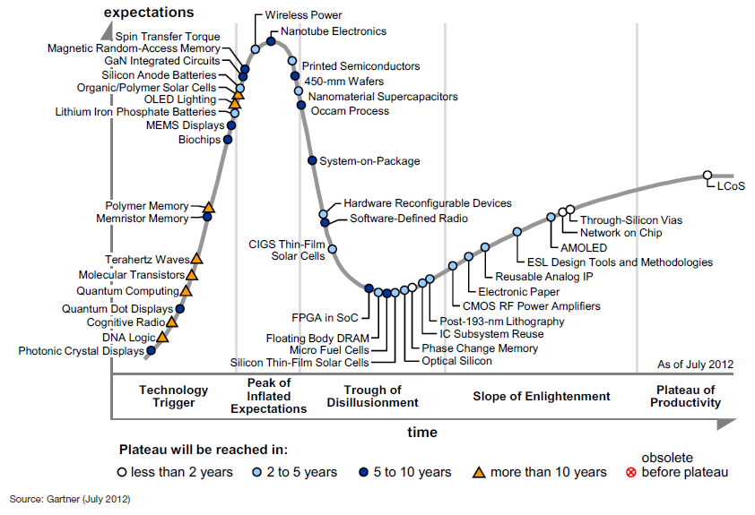
Global Electronics MI: Technology Trends Hype Cycle
Notes:
Sources:
http://www.articlesbase.com/project-management-articles/semiconductors-changing-business-models-to-meet-the-post-silicon-era-the-semiconductor-silicon-era-after-the-electronics-industry-3295122.html#ixzz1Jxm3nE1W PWC Report: A change of pace in the semiconductor industry, November 2009
http://www2.renesas.com/news/en/archive/0904/2701.html
http://www.ft.com/cms/s/2/1391c66e-35e8-11de-a997-00144feabdc0.html#ixzz1JxpXBuwZ
http://www.cio.in/news/ti-buys-national-semiconductor-65-billion-103862011

Slide 40
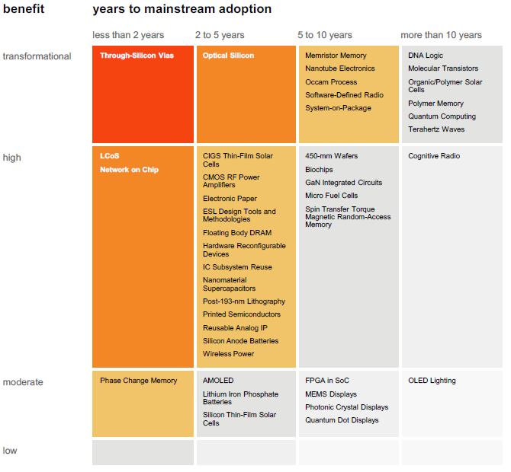
Global Electronics MI: Technology Trends Priority Matrix
Notes:
Sources:
http://www.articlesbase.com/project-management-articles/semiconductors-changing-business-models-to-meet-the-post-silicon-era-the-semiconductor-silicon-era-after-the-electronics-industry-3295122.html#ixzz1Jxm3nE1W PWC Report: A change of pace in the semiconductor industry, November 2009
http://www2.renesas.com/news/en/archive/0904/2701.html
http://www.ft.com/cms/s/2/1391c66e-35e8-11de-a997-00144feabdc0.html#ixzz1JxpXBuwZ
http://www.cio.in/news/ti-buys-national-semiconductor-65-billion-103862011

Slide 41
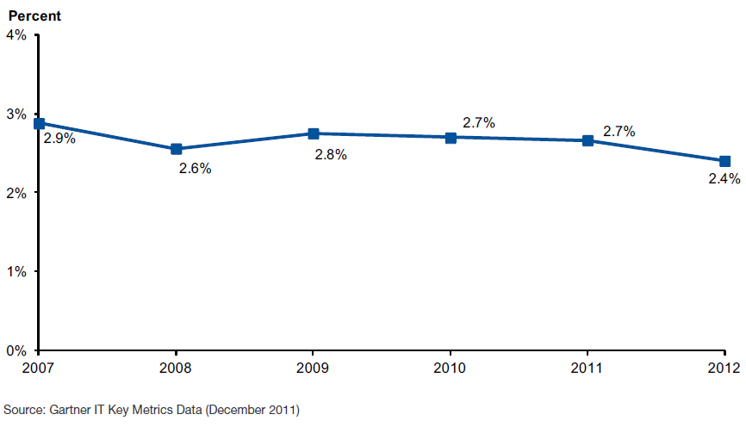
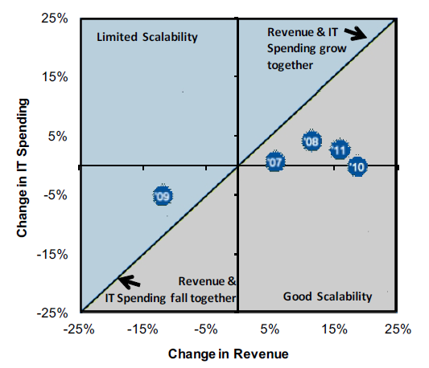
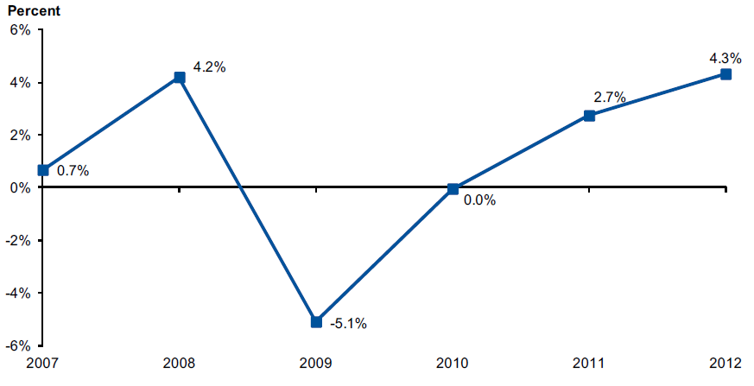
Global Electronics MI: Technology Trends IT Spending Trend
Industrial Electronic and Electrical Equipment: IT Spending as a % of Revenue *
Agility: Revenue % Change vs. IT Spending
% Change
Industrial Electronic and Electrical Equipment: IT Spending % Change
IT spending as a % of revenue is showing a downward trends with the percentage IT spending being the lowest since 2007
Though the IT Spending % is dropping, but the Agility has improved significantly in last five years
* IT Spending as a % of revenue is calculated on the basis of the current year's IT spending divided by the previous revenue expenses
Notes:
Sources:
http://www.articlesbase.com/project-management-articles/semiconductors-changing-business-models-to-meet-the-post-silicon-era-the-semiconductor-silicon-era-after-the-electronics-industry-3295122.html#ixzz1Jxm3nE1W PWC Report: A change of pace in the semiconductor industry, November 2009
http://www2.renesas.com/news/en/archive/0904/2701.html
http://www.ft.com/cms/s/2/1391c66e-35e8-11de-a997-00144feabdc0.html#ixzz1JxpXBuwZ
http://www.cio.in/news/ti-buys-national-semiconductor-65-billion-103862011

Slide 42
Global Electronics MI: Technology Trends IT Spending Trend
Industrial Electronic and Electrical Equipment: Distribution of IT Cost by Technology Domain
Notes:
Sources:
http://www.articlesbase.com/project-management-articles/semiconductors-changing-business-models-to-meet-the-post-silicon-era-the-semiconductor-silicon-era-after-the-electronics-industry-3295122.html#ixzz1Jxm3nE1W PWC Report: A change of pace in the semiconductor industry, November 2009
http://www2.renesas.com/news/en/archive/0904/2701.html
http://www.ft.com/cms/s/2/1391c66e-35e8-11de-a997-00144feabdc0.html#ixzz1JxpXBuwZ
http://www.cio.in/news/ti-buys-national-semiconductor-65-billion-103862011

Slide 43
Global Electronics MI: Table of Content
Market Overview
Competitive Landscape
Deals Space
Business Trends
Technology Trends
Market Drivers
Industry Growth Drivers & Challenges
Market Future
Disclaimer:
The information presented in this report is based on data available in the public domain. If you find that it is incorrect, please let us know.
- 43 -

Slide 44
Global Electronics MI: Market Drivers Industry Growth Drivers & Challenges
Growth Drivers
Huge demand for iPad, tablets & notebooks as low to mid-range portable PCs continue to dominate the market.
Growth Challenges
Shorter product life cycles in consumer electronics.
Increasing demand of smart phones, LCD & Plasma TV screens, music players and other electronics gadgets.
Rising demand in consumer electronics due to economic growth in Emerging markets.
Solid growth expected in much larger markets of North America, Europe and Asia Pacific.
Silicon shortage in semiconductor industry due to the disaster in Japan may affect the demand queues in consumer electronics industry.
Slowed operations in Japanese semiconductor wafer fabs can lead to a foundry wafer pricing increase in the near term
Global economic downturn causing lower demand
Smartphone and Table Computer Ownership an Purchase Plans Growin Exponentially
- 44 -
Notes:
Sources:
http://blogs.forrester.com/andrew_bartels/11-01-10- tech_market_will_see_similar_growth_in_2011_as_in_2010_but_with_important_twists
Ovum Report: 2011 Trends to Watch – Storage, January 2011
http://www.techcrunchit.com/2010/06/15/idc-sees-pc-market-grow-by-19-8-in-2010/
http://www.edmontonnaoshweek.com/hardware/global-computer-hardware-industry-the-growth-of-individual-segments.html

Slide 45
Global Electronics MI: Table of Content
Market Overview
Competitive Landscape
Deals Space
Business Trends
Technology Trends
Market Drivers
Market Future
Market Forecast
Disclaimer:
The information presented in this report is based on data available in the public domain. If you find that it is incorrect, please let us know.
- 45 -

Slide 46
Global Electronics MI: Market Future Market Forecast
Global Electronic Equipment & Instruments
Global consumer electronics sales will increase despite the poor 2012 economic outlook. This year will also be the year of smartphones worth up to US$ 100 reaching 500 million units sold and NFC (Near Field Communication) technology winning 200 million users by the year-end.
As in previous years, tablets continue to penetrate both the global and the regional markets strongly. Deloitte's analysts forecast that almost 5 percent of the total number of tablets sold will be in the hands of private users already possessing a tablet. This represents the fastest growing demand segment on the market.
Despite a high offer of digital video devices, the expectations are that video on demand (VOD) will see no robust upswing in 2012, as the trend to watch content when broadcast will continue. On the other hand, owners of portable devices, who will watch 5 billion hours of missed TV content while on travel or commuting using public means of transportation, will mitigate the trend.
Notes:
Sources:
Datamontior: Global Electronic Equipment & Instruments Publication Date: may 2012

Slide 47
Global Electronics MI: Market Future Market Forecast
Global Electronic Equipment & Instruments
Year | $ billion | % Growth
2011 | 1,844.3 | 4.33%
2012 | 1,931.0 | 4.70%
2013 | 2,070.4 | 7.22%
2014 | 2,134.5 | 3.10%
2015 | 2,267.1 | 6.21%
2016 | 2,426.0 | 7.01%
CAGR: 2011–16 |  | 5.64%
$ billion (e)
% growth
Year
Notes:
Sources:
Datamontior: Global Electronic Equipment & Instruments Publication Date: may 2012

Slide 48
Global Electronics MI: Market Future Market Forecast
Global Electronic Manufacturing Services
Year | $ billion | % Growth
2011 | 219.60 | 12.85%
2012 | 221.20 | 0.73%
2013 | 234.20 | 5.88%
2014 | 248.80 | 6.23%
2015 | 265.00 | 6.51%
2016 | 283.10 | 6.83%
CAGR: 2011–16 |  | 5.21%
$ billion (e)
% growth
Year
Notes:
Sources:
Datamontior: Global Electronic Manufacturing Services Publication Date: may 2012

Slide 49
Global Electronics MI: Market Future Market Forecast
Global Electronic Components
Year | $ billion | % Growth
2011 | 151.10 | 5.15%
2012 | 160.30 | 6.09%
2013 | 171.60 | 7.05%
2014 | 186.80 | 8.86%
2015 | 206.10 | 10.33%
2016 | 229.70 | 11.45%
CAGR: 2011–16 |  | 8.74%
$ billion (e)
% growth
Year
Notes:
Sources:
Datamontior: Global Electronic Components Publication Date: may 2012

Slide 50
Global Electronics MI: Market Future Market Forecast
Global Consumer Electronics
Year | $ billion | % Growth
2011 | 284.1 | 4.65%
2012 | 296.2 | 4.25%
2013 | 308.9 | 4.32%
2014 | 320.7 | 3.79%
2015 | 331.6 | 3.43%
2016 | 343.4 | 3.53%
CAGR: 2011–16 |  | 3.86%
$ billion (e)
% growth
Year
Notes:
Sources:
Datamontior: Global Electronic Components Publication Date: may 2012

Slide 51
Thank you for reading the report. Was the report useful to you? Do you need more research?
Please send your comments / suggestions to:
swati.malaker@tcs.com
aditi.royghatak@tcs.com

